Slide 1
White-Box Testing (Part 1)
Dr. Durga Prasad Mohapatra
Professor
Department Of Computer Sc. & Engineering
NIT, Rourkela.
03/08/10

Slide 2
Defect Reduction Techniques
Review
Testing
Formal verification
Development process
Systematic methodologies

Slide 3



Why Test?
Ariane 5 rocket self-destructed 37 seconds after launch
Reason: A control software bug that went undetected
  Conversion from 64-bit floating point to 16-bit signed integer value had caused an exception
    The floating point number was larger than 32767
    Efficiency considerations had led to the disabling of the exception handler.
Total Cost: over $1 billion

Slide 4
How Do You Test a Program?
Input test data to the program.
Observe the output:
  Check if the program behaved as expected.

Slide 5



How Do You Test a Program?

Slide 6
How Do You Test a Program?
If the program does not behave as expected:
  Note the conditions under which it failed.
  Later debug and correct.

Slide 7
What’s So Hard About Testing ?
Consider int proc1(int x, int y)
Assuming a 64 bit computer
  Input space = 2¹²⁸
Assuming it takes 10secs to key-in an integer pair
  It would take about a billion years to enter all possible values!
  Automatic testing has its own problems!
Notes:
(But, can think about doing this many tests today)

Slide 8
Testing Facts
Consumes largest effort among all phases
  Largest manpower among all other development roles
  Implies more job opportunities
About 50% development effort
  But 10% of development time?
  How?

Slide 9
Testing Facts
Testing is getting more complex and sophisticated every year.
  Larger and more complex programs
  Newer programming paradigms

Slide 10
Overview of Testing Activities
Test Suite Design
Run test cases and observe results to detect failures.
Debug to locate errors
Correct errors.

Slide 11
Error, Faults, and Failures
A failure is a manifestation of an error (also defect or bug).
  Mere presence of an error may not lead to a failure.

Slide 12
Pesticide Effect
Errors that escape a fault detection technique:
  Can not be detected by further applications of that technique.

Slide 13
Pesticide Effect
Assume we use 4 fault detection techniques and 1000 bugs:
  Each detects only 70% bugs
  How many bugs would remain
  1000*(0.3)⁴=81 bugs

Slide 14
Fault Model
Types of faults possible in a program.
Some types can be ruled out
  Concurrency related-problems in a sequential program

Slide 15
Fault Model of an OO Program
OO Faults
Structural Faults
Algorithmic Faults
Procedural Faults
Traceability Faults
OO
Faults
Incorrect Result
Inadequate Performance

Slide 16
Hardware Fault-Model
Simple:
  Stuck-at 0
  Stuck-at 1
  Open circuit
  Short circuit
Simple ways to test the presence of each
Hardware testing is fault-based testing

Slide 17
Software Testing
Each test case typically tries to establish correct working of some functionality
  Executes (covers) some program elements
  For restricted types of faults, fault-based testing exists.

Slide 18
Test Cases and Test Suites
Test a software using a set of carefully designed test cases:
  The set of all test cases is called the test suite

Slide 19
Test Cases and Test Suites
A test case is a triplet [I,S,O]
  I is the data to be input to the system,
  S is the state of the system at which the data will be input,
  O is the expected output of the system.

Slide 20
Verification versus Validation
Verification is the process of determining:
  Whether output of one phase of development conforms to its previous phase.
Validation is the process of determining:
  Whether a fully developed system conforms to its SRS document.

Slide 21
Verification versus Validation
Verification is concerned with phase containment of errors,
  Whereas the aim of validation is that the final product be error free.

Slide 22
Design of Test Cases
Exhaustive testing of any non-trivial system is impractical:
  Input data domain is extremely large.
Design an optimal test suite:
  Of reasonable size and
  Uncovers as many errors as possible.

Slide 23
Design of Test Cases
If test cases are selected randomly:
  Many test cases would not contribute to the significance of the test suite,
  Would not detect errors not already being detected by other test cases in the suite.
Number of test cases in a randomly selected test suite:
  Not an indication of effectiveness of testing.

Slide 24
Design of Test Cases
Testing a system using a large number of randomly selected test cases:
  Does not mean that many errors in the system will be uncovered.
Consider following example:
  Find the maximum of two integers x and y.

Slide 25
Design of Test Cases
The code has a simple programming error:
If (x>y) max = x;
else max = x;
Test suite {(x=3,y=2);(x=2,y=3)} can detect the error,
A larger test suite {(x=3,y=2);(x=4,y=3); (x=5,y=1)} does not detect the error.

Slide 26
Design of Test Cases
Systematic approaches are required to design an optimal test suite:
  Each test case in the suite should detect different errors.

Slide 27
Design of Test Cases
There are essentially three main approaches to design test cases:
  Black-box approach
  White-box (or glass-box) approach
  Grey-box testing

Slide 28
Black-Box Testing
Test cases are designed using only functional specification of the software:
  Without any knowledge of the internal structure of the software.
For this reason, black-box testing is also known as functional testing.

Slide 29
White-box Testing
Designing white-box test cases:
  Requires knowledge about the internal structure of software.
  White-box testing is also called structural testing.
  In this unit we will not study white-box testing.

Slide 30
White-Box Testing
There exist several popular white-box testing methodologies:
  Statement coverage
  Branch coverage
  Path coverage
  Condition coverage
  MC/DC coverage
  Mutation testing
  Data flow-based testing

Slide 31
Why Both BB and WB Testing?
Black-box
Impossible to write a test case for every possible set of inputs and outputs
Some code parts may not be reachable
Does not tell if extra functionality has been implemented.
White-box
Does not address the question of whether or not a program matches the specification
Does not tell you if all of the functionality has been implemented
Does not discover missing program logic

Slide 32
Coverage-Based Testing Versus Fault-Based Testing
Idea behind coverage-based testing:
  Design test cases so that certain program elements are executed (or covered).
  Example: statement coverage, path coverage, etc.
Idea behind fault-based testing:
  Design test cases that focus on discovering certain types of faults.
  Example: Mutation testing.

Slide 33
Statement Coverage
Statement coverage methodology:
  Design test cases so that every statement in the program is executed at least once.

Slide 34
Statement Coverage
The principal idea:
  Unless a statement is executed,
  We have no way of knowing if an error exists in that statement.

Slide 35
Statement Coverage Criterion
Observing that a statement behaves properly for one input value:
  No guarantee that it will behave correctly for all input values.

Slide 36
Statement Testing
Coverage measurement:
# executed statements
# statements
Rationale: a fault in a statement can only be revealed by executing the faulty statement
Notes:
12.2 STATEMENT TESTING

Slide 37
Example
int f1(int x, int y){
1 while (x != y){
2 if (x>y) then
3 x=x-y;
4 else y=y-x;
5 }
6 return x; }
Euclid's GCD Algorithm

Slide 38
Euclid's GCD Algorithm
By choosing the test set {(x=3,y=3),(x=4,y=3), (x=3,y=4)}
  All statements are executed at least once.

Slide 39
Branch Coverage
Test cases are designed such that:
  Different branch conditions
    Given true and false values in turn.

Slide 40
Branch Coverage
Branch testing guarantees statement coverage:
  A stronger testing compared to the statement coverage-based testing.

Slide 41
Stronger Testing
Test cases are a superset of a weaker testing:
  A stronger testing covers at least all the elements of the elements covered by a weaker testing.

Slide 42
Stronger, Weaker, and Complementary Testing
Complementary
Weaker

Slide 43
Example
int f1(int x,int y){
1 while (x != y){
2 if (x>y) then
3 x=x-y;
4 else y=y-x;
5 }
6 return x; }

Slide 44
Example
Test cases for branch coverage can be:
{(x=3,y=3),(x=3,y=2), (x=4,y=3), (x=3,y=4)}

Slide 45
Branch Testing
Adequacy criterion: Each branch (edge in the CFG) must be executed at least once
Coverage:
# executed branches
# branches

Slide 46
Statements vs Branch Testing
Traversing all edges of a graph causes all nodes to be visited
  So test suites that satisfy the branch adequacy criterion for a program P also satisfy the statement adequacy criterion for the same program
The converse is not true
  A statement-adequate (or node-adequate) test suite may not be branch-adequate (edge-adequate)
Notes:
The example of two slides ago illustrates this point

Slide 47
All Branches can still miss conditions
Sample fault: missing operator (negation)
digit_high == 1 || digit_low == -1
Branch adequacy criterion can be satisfied by varying only digit_low
  The faulty sub-expression might never determine the result
  We might never really test the faulty condition, even though we tested both outcomes of the branch
Notes:
Recall we’re trying to exercise each of the significant cases in the code. A single
branch statement (“if”, “while”, etc.) may actually combine different cases in a
complex condition, and exercising both outcomes of the branch may not exercise
each part of the complex condition.

Slide 48
Condition Coverage
Test cases are designed such that:
  Each component of a composite conditional expression
    Given both true and false values.

Slide 49
Example
Consider the conditional expression
  ((c1.and.c2).or.c3):
Each of c1, c2, and c3 are exercised at least once,
  i.e. given true and false values.

Slide 50
Basic condition testing
Adequacy criterion: each basic condition must be executed at least once
Coverage:
# truth values taken by all basic conditions
2 * # basic conditions
Notes:
the total number of truth values that the basic conditions can take is twice the number of basic conditions, since each basic condition can assume value true or false

Slide 51
Branch Testing
Branch testing is the simplest condition testing strategy:
  Compound conditions appearing in different branch statements
    Are given true and false values.

Slide 52
Branch Testing
Condition testing:
  Stronger testing than branch testing.
Branch testing:
  Stronger than statement coverage testing.

Slide 53
Condition Coverage
Consider a boolean expression having n components:
  For condition coverage we require 2^{n} test cases.
Condition coverage-based testing technique:
  Practical only if n (the number of component conditions) is small.

Slide 54
Modified condition/decision (MC/DC)
Motivation: Effectively test important combinations of conditions, without exponential blowup in test suite size
  “Important” combinations means: Each basic condition shown to independently affect the outcome of each decision
Requires:
  For each basic condition C, two test cases,
  values of all evaluated conditions except C are the same
  compound condition as a whole evaluates to true for one and false for the other
Notes:
If we don’t want to test all possible combinations, then we have to say which combinations are important.
One good choice is to choose combinations that show how each basic condition can affect the outcome,
i.e., how changing that one condition can change the value of the whole compound condition. That’s
what the “modified condition/decision” criterion requires.

Slide 55
What is MC/DC?
MC/DC stands for Modified Condition / Decision Coverage
A kind of Predicate Coverage technique
  Condition: Leaf level Boolean expression.
  Decision: Controls the program flow.
Main idea: Each condition must be shown to independently affect the outcome of a decision, i.e. the outcome of a decision changes as a result of changing a single condition.

Slide 56
Condition Coverage
Every condition in the decision has taken all possible outcomes at least once.
If ((a) & (b) | (c)) then…
true
false
true
false
true
false

Slide 57
MC/DC Coverage
Every condition in the decision independently affects the decision’s outcome.
If ((a) & (b) | (c)) then…
true
false
true
false
Change the value of each condition individually while keeping all other conditions constant.

Slide 58
MC/DC: linear complexity
N+1 test cases for N basic conditions
(((a || b) && c) || d) && e
Test a b c d e outcome
Case
(1) true -- true -- true true
(2) false true true -- true true
(3) true -- false true true true
(6) true -- true -- false false
(11) true -- false false -- false
(13) false false -- false -- false
Underlined values independently affect the output of the decision
Required by the RTCA/DO-178B standard
Notes:
This is the same table as two slides ago, omitting redundant cases.
Cases 4,5, 7-10, and 12 have been omitted.
In each column we find two rows in which that column is underlined. For example, the “a” column
is underlined in rows (1) and (13). All the evaluated conditions in those two rows are the same
except for that column. For example, to show that changing “a” from true to false in case (1) would
change the outcome, we
* Fill in the “don’t care” columns in row 1 with values from row 13 (because this doesn’t change
anything
* Then see that the rows are completely identical except in column “a” and the outcome
so clearly changing the value of “a” changed the outcome.
The number of test cases needed is hardly more than for basic condition coverage, but MC/DC is
much better than basic condition coverage at exposing faults in conditional expressions, so it is
clearly superior (and therefore very widely used, and specified in some standards).

Slide 59
Comments on MC/DC
MC/DC is
  basic condition coverage (C)
  branch coverage (DC)
  plus one additional condition (M):
  every condition must independently affect the decision’s output
It is subsumed by compound conditions and subsumes all other criteria discussed so far
  stronger than statement and branch coverage
A good balance of thoroughness and test size (and therefore widely used)
Notes:
(This mainly restates comments on the previous slide, and can be used
or skipped depending on lecture style)

Slide 60
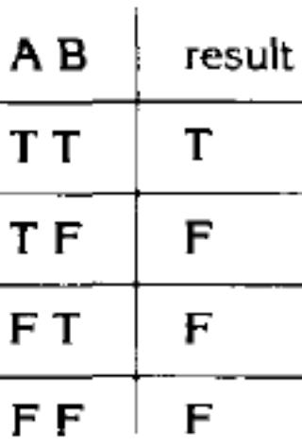
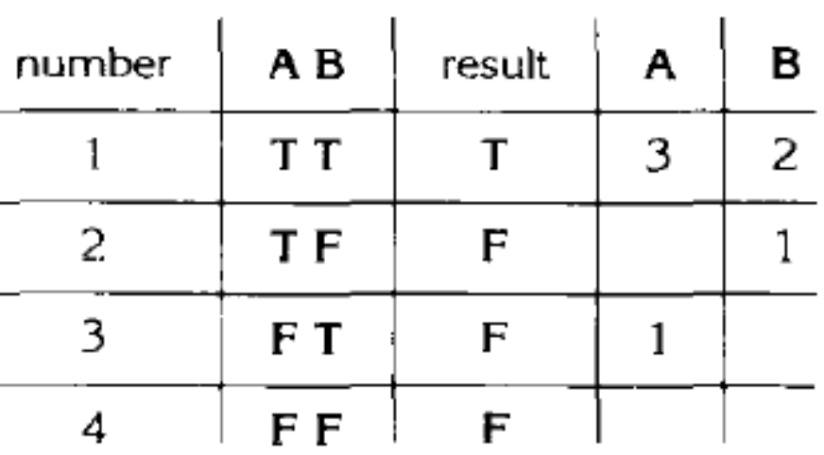
Creating MC/DC test cases
If (A and B) then…
(1) create truth table for conditions.
(2) Extend truth table so that it indicated which test cases can be used to show the independence of each condition.
Notes:
(T,T) test is required as it is the only one that returns true
(F,T) test is required as it is the only test that changes the value of only A and also changes the decision's outcome, thereby establishing the independence of A In similar fashion
(T,T) and (T,F) tests are required to show the independence of B.
Test set {(T,T), (T,F), (F,T)} satisfies MC/DC for the expression A and B.

Slide 61
Creating test cases cont’d
Show independence of A:
  Take 1 + 3
Show independence of B:
  Take 1 + 2
Resulting test cases are
  1 + 2 + 3
  (T , T) + (T , F) + (F , T)

Slide 62
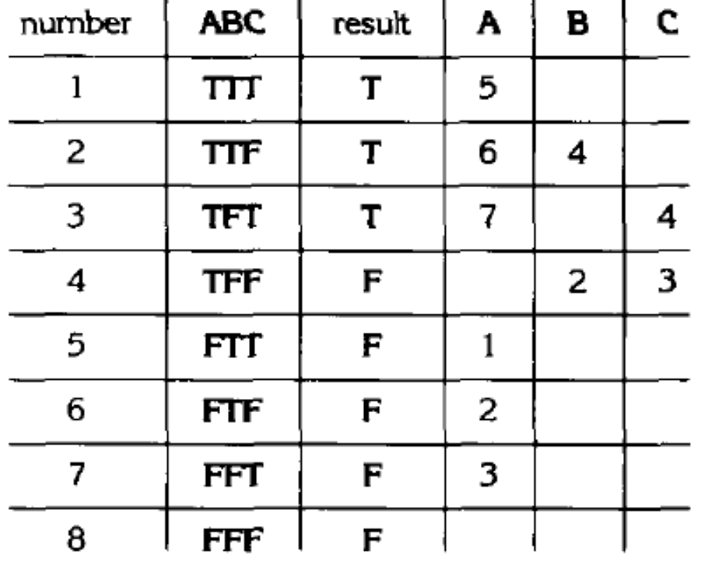
More advanced example
If (A and (B or C)) then…
Note: We want to determine the MINIMAL set of test cases
Here:
{2,3,4,6}
{2,3,4,7}
Non-minimal set is:
{1,2,3,4,5}

Slide 63
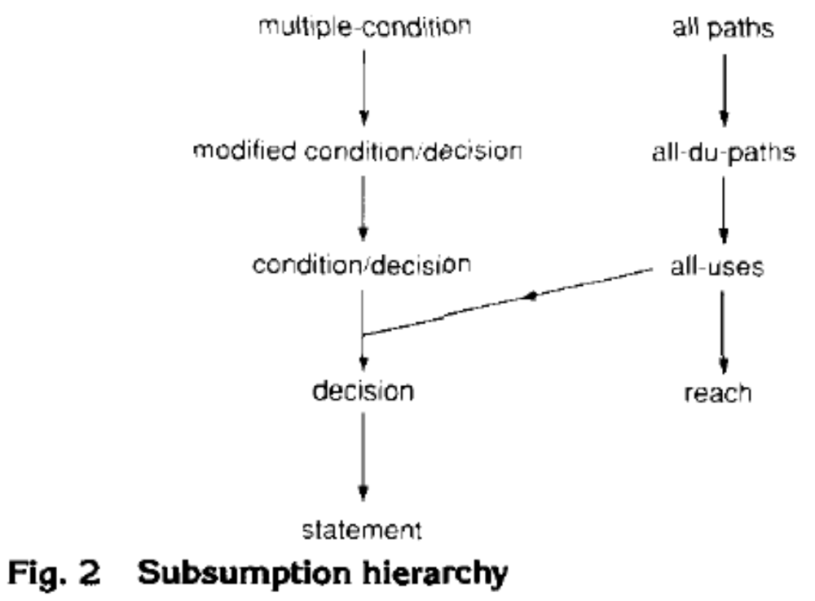
Where does it fit in?
The MC/DC criterion is much stronger than the condition/decision coverage criterion, but the number of test cases to achieve the MC/DC criterions still varies linearly with the number of conditions n in the decisions.
  Much more complete coverage than condition/decision coverage, but
  at the same time it is not terribly costly in terms of number of test cases.

Slide 64
Path Coverage
Design test cases such that:
  All linearly independent paths in the program are executed at least once.
Defined in terms of
  Control flow graph (CFG) of a program.

Slide 65
Path Coverage-Based Testing
To understand the path coverage-based testing:
  we need to learn how to draw control flow graph of a program.
A control flow graph (CFG) describes:
  The sequence in which different instructions of a program get executed.
  The way control flows through the program.

Slide 66
How to Draw Control Flow Graph?
Number all statements of a program.
Numbered statements:
  Represent nodes of control flow graph.
An edge from one node to another node exists:
  If execution of the statement representing the first node
    Can result in transfer of control to the other node.

Slide 67
Example
int f1(int x,int y){
1 while (x != y){
2 if (x>y) then
3 x=x-y;
4 else y=y-x;
5 }
6 return x; }

Slide 68
Example Control Flow Graph
1
2
3
4
5
6

Slide 69
How to Draw Control flow Graph?
Sequence:
  1 a=5;
  2 b=a*b-1;
1
2

Slide 70
How to Draw Control Flow Graph?
Selection:
  1 if(a>b) then
  2 c=3;
  3 else c=5;
  4 c=c*c;
1
2
3
4

Slide 71
How to Draw Control Flow Graph?
Iteration:
  1 while(a>b){
  2 b=b*a;
  3 b=b-1;}
  4 c=b+d;
1
2
3
4

Slide 72
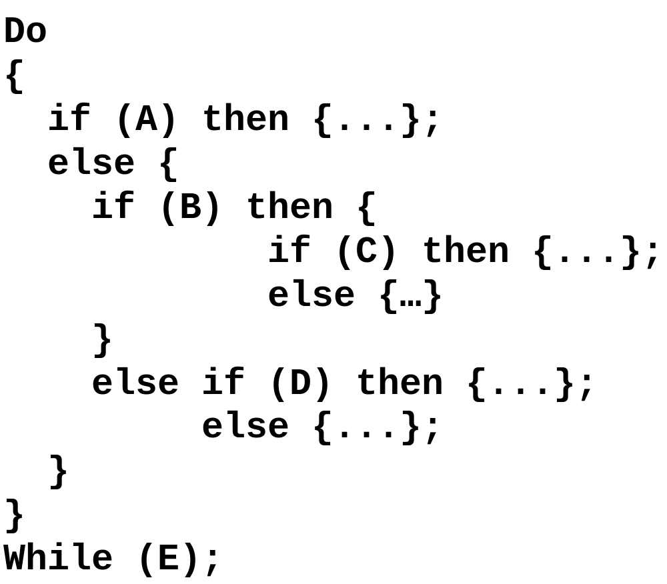
Example Code Fragment

Slide 73
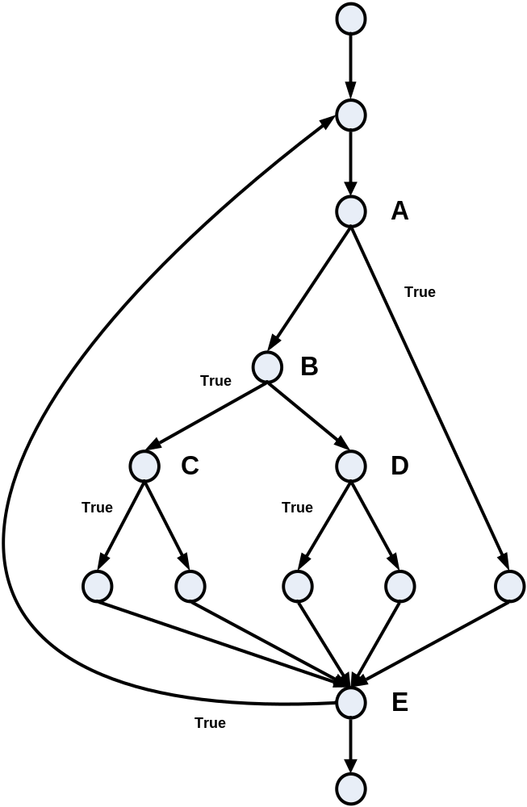
Example Control Flow Graph
Source: The Art of Software Testing – Glenford Myers

Slide 74
Path
A path through a program:
  A node and edge sequence from the starting node to a terminal node of the control flow graph.
  There may be several terminal nodes for program.

Slide 75
Linearly Independent Path
Any path through the program:
  Introduces at least one new edge:
    Not included in any other independent paths.

Slide 76
Independent path
It is straight forward:
  To identify linearly independent paths of simple programs.
For complicated programs:
  It is not easy to determine the number of independent paths.

Slide 77
McCabe's Cyclomatic Metric
An upper bound:
  For the number of linearly independent paths of a program
Provides a practical way of determining:
  The maximum number of linearly independent paths in a program.

Slide 78
McCabe's Cyclomatic Metric
Given a control flow graph G,
cyclomatic complexity V(G):
  V(G)= E-N+2
    N is the number of nodes in G
    E is the number of edges in G

Slide 79
Example Control Flow Graph
1
Cyclomatic complexity =
7-6+2 = 3.
2
3
4
5
6

Slide 80
Cyclomatic Complexity
Another way of computing cyclomatic complexity:
  inspect control flow graph
  determine number of bounded areas in the graph
V(G) = Total number of bounded areas + 1
  Any region enclosed by a nodes and edge sequence.

Slide 81
Example Control Flow Graph
1
2
3
4
5
6

Slide 82
Example
From a visual examination of the CFG:
  Number of bounded areas is 2.
  Cyclomatic complexity = 2+1=3.

Slide 83
Cyclomatic Complexity
McCabe's metric provides:
    A quantitative measure of testing difficulty and the ultimate reliability
Intuitively,
  Number of bounded areas increases with the number of decision nodes and loops.

Slide 84
Cyclomatic Complexity
The first method of computing V(G) is amenable to automation:
  You can write a program which determines the number of nodes and edges of a graph
  Applies the formula to find V(G).

Slide 85
Cyclomatic Complexity
The cyclomatic complexity of a program provides:
  A lower bound on the number of test cases to be designed
  To guarantee coverage of all linearly independent paths.

Slide 86
Cyclomatic Complexity
A measure of the number of independent paths in a program.
Provides a lower bound:
  for the number of test cases for path coverage.

Slide 87
Cyclomatic Complexity
Knowing the number of test cases required:
  Does not make it any easier to derive the test cases,
  Only gives an indication of the minimum number of test cases required.

Slide 88
Practical Path Testing
The tester proposes initial set of test data :
  Using his experience and judgement.
A dynamic program analyzer used:
  Measures which parts of the program have been tested
  Result used to determine when to stop testing.

Slide 89
Derivation of Test Cases
Draw control flow graph.
Determine V(G).
Determine the set of linearly independent paths.
Prepare test cases:
  to force execution along each path.

Slide 90
Example
int f1(int x,int y){
1 while (x != y){
2 if (x>y) then
3 x=x-y;
4 else y=y-x;
5 }
6 return x; }

Slide 91
Example Control Flow Diagram
1
2
3
4
5
6

Slide 92
Derivation of Test Cases
Number of independent paths: 3
  1,6 test case (x=1, y=1)
  1,2,3,5,1,6 test case(x=1, y=2)
  1,2,4,5,1,6 test case(x=2, y=1)

Slide 93
An Interesting Application of Cyclomatic Complexity
Relationship exists between:
  McCabe's metric
  The number of errors existing in the code,
  The time required to find and correct the errors.

Slide 94
Cyclomatic Complexity
Cyclomatic complexity of a program:
  Also indicates the psychological complexity of a program.
  Difficulty level of understanding the program.

Slide 95
Cyclomatic Complexity
From maintenance perspective,
  Limit cyclomatic complexity of modules
    To some reasonable value.
  Good software development organizations:
    Restrict cyclomatic complexity of functions to a maximum of ten or so.

Slide 96
White-Box Testing : Summary
weakest
statement
coverage
condition
coverage
branch
(or decision)
coverage
branch and condition
(or condition /decision) coverage
independent path (or basis path)
coverage
modified condition / decision coverage
multiple- condition
coverage
only if paths across composite conditions are distinguished
strongest
path
coverage

Slide 97
Data Flow-Based Testing
Selects test paths of a program:
  According to the locations of
    Definitions and uses of different variables in a program.

Slide 98
Data Flow-Based Testing
For a statement numbered S,
  DEF(S) = {X/statement S contains a definition of X}
  USES(S)= {X/statement S contains a use of X}
  Example: 1: a=b; DEF(1)={a}, USES(1)={b}.
  Example: 2: a=a+b; DEF(1)={a}, USES(1)={a,b}.

Slide 99
Data Flow-Based Testing
A variable X is said to be live at statement S1, if
  X is defined at a statement S:
  There exists a path from S to S1 not containing any definition of X.

Slide 100
DU Chain Example
1 X(){
2 a=5; /* Defines variable a */
3 While(C1) {
4 if (C2)
5 b=a*a; /*Uses variable a */
6 a=a-1; /* Defines variable a */
7 }
8 print(a); } /*Uses variable a */

Slide 101
Definition-use chain (DU chain)
[X,S,S1],
  S and S1 are statement numbers,
  X in DEF(S)
  X in USES(S1), and
  the definition of X in the statement S is live at statement S1.

Slide 102
Data Flow-Based Testing
One simple data flow testing strategy:
  Every DU chain in a program be covered at least once.
Data flow testing strategies:
  Useful for selecting test paths of a program containing nested if and loop statements.

Slide 103
Data Flow-Based Testing
    1 X(){
    2 B1; /* Defines variable a */
    3 While(C1) {
    4 if (C2)
    5 if(C4) B4; /*Uses variable a */
    6 else B5;
    7 else if (C3) B2;
    8 else B3; }
    9 B6 }

Slide 104
Data Flow-Based Testing
[a,1,5]: a DU chain.
Assume:
  DEF(X) = {B1, B2, B3, B4, B5}
  USED(X) = {B2, B3, B4, B5, B6}
  There are 25 DU chains.
However only 5 paths are needed to cover these chains.

Slide 105
Mutation Testing
The software is first tested:
  using an initial testing method based on white-box strategies we already discussed.
After the initial testing is complete,
  mutation testing is taken up.
The idea behind mutation testing:
  make a few arbitrary small changes to a program at a time.

Slide 106
Mutation Testing
Each time the program is changed,
  it is called a mutated program
  the change is called a mutant.

Slide 107
Mutation Testing
A mutated program:
  Tested against the full test suite of the program.
If there exists at least one test case in the test suite for which:
  A mutant gives an incorrect result,
  Then the mutant is said to be dead.

Slide 108
Mutation Testing
If a mutant remains alive:
  even after all test cases have been exhausted,
  the test suite is enhanced to kill the mutant.
The process of generation and killing of mutants:
  can be automated by predefining a set of primitive changes that can be applied to the program.

Slide 109
Mutation Testing
The primitive changes can be:
  altering an arithmetic operator,
  changing the value of a constant,
  changing a data type, etc.

Slide 110
Mutation Testing
A major disadvantage of mutation testing:
  computationally very expensive,
  a large number of possible mutants can be generated.

Slide 111
Summary
Exhaustive testing of non-trivial systems is impractical:
  We need to design an optimal set of test cases
    Should expose as many errors as possible.
If we select test cases randomly:
  many of the selected test cases do not add to the significance of the test set.

Slide 112
Summary
There are two approaches to testing:
  black-box testing and
  white-box testing.
Designing test cases for black box testing:
  does not require any knowledge of how the functions have been designed and implemented.
  Test cases can be designed by examining only SRS document.

Slide 113
Summary
White box testing:
  Requires knowledge about internals of the software.
  Design and code is required.
We have discussed a few white-box test strategies.
  Statement coverage
  branch coverage
  condition coverage
  path coverage

Slide 114
Summary
A stronger testing strategy:
  Provides more number of significant test cases than a weaker one.
  Condition coverage is strongest among strategies we discussed.
We discussed McCabe’s Cyclomatic complexity metric:
  Provides an upper bound for linearly independent paths
  Correlates with understanding, testing, and debugging difficulty of a program.

